Slide 1

Interviewing and Screening Volunteers
Montgomery County Volunteer Center
February 5, 2020

Slide 2
Introductions
Name
Organization
Take Aways

Slide 3
Why Screen Volunteers?
Screening helps us find the right person for the volunteer opportunity to ensure success for the organization and the volunteer. Without proper screening, we may miss red flags, poor alignment between skills and the job, or make wrong assumptions about fit. How do you make sure you have the right person the first time?

Slide 4

Effective Interviewing and Screening
Meets funding, grant and safety requirements
Saves time
Saves money
Creates an effective team
Protects brand and reputation
Creates a pipeline to more volunteers

Slide 5

Steps to Effective Recruitment
Job Description
Volunteer Application Process
Phone Interview
In Person Interview(s)
Background Checks
Skills Check

Slide 6



Question
Why Is It Important to Start With a Job Description?

Slide 7

Answer
You can't get what you want, if you don't know what you are looking for!

Slide 8
Job Description

Slide 9

An Effective Volunteer Job Description Includes the Following
Mission
Volunteer Role or Job(s)
Schedule or Expected Commitments
Minimum Requirements
Training
Expectations
How to Apply

Slide 10
Volunteer Applications and Assessments

Slide 11

Volunteer Applications
Many qualifying questions can be asked on the volunteer application so volunteers can self-screen. It is a balance between asking the right questions and making an application user friendly.

Slide 12
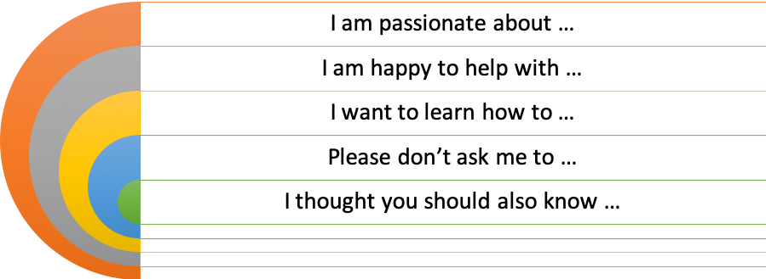
Volunteer Assessments

Slide 13
Discussion
What do you include in your volunteer application that you find helpful for volunteers to self-screen?

Slide 14
The Phone Interview
The Key To Effective Screening

Slide 15

Effective Phone Screening
Preparation is key. To craft an effective phone interview, consider the following:
Determine what really matters
Leave time to prep and review resume and application information
Explain application procedures and expectations
Be consistent with your questions
Be prepared to leave time to discuss and answer questions

Slide 16
In person and Group Interview
The Key To Effective Screening

Slide 17

Double Check Your Own Biases
Halo/Horns
Affinity Bias
Relying On Early Assumptions or Anchoring Bias
Confirmation Bias
Nonverbals Bias

Slide 18

Developing Interview Questions
Here are some critical pieces of information you might want to learn about your applicant during an interview.
What are the causes they feel passionately about?
What are their “Must Have’s” and “Non-Negotiables”?
What brings them the most joy?
How do they like to be appreciated?
What adjustments can be made to address the volunteer’s needs?
Have they met your minimum qualifications?
What skills do they have to share?
How does the volunteer react to specific situations?

Slide 19

Sample Questions
Why would you like to be a volunteer at our organization?
Why do you like helping others?
Can you tell me about an aspect of a volunteer experience that you’ve really enjoyed, and a part that you wish had been different?
What do you like to do in your free time?
How much time would you like spend in a volunteer role?
What are your expectations for this volunteer position?

Slide 20
Team Activity
Create 3 Interview Questions your team Finds Effective For Screening

Slide 21
Remember…
Always
Be
Consistent

Slide 22
Prepping For A Successful Interview

Slide 23

Set Up For A Great Interview
Greet volunteer
Put volunteer at ease
Review program mission and goals
Review job description, schedule and expectations
Ask prepared questions
Allow for questions
Review next steps
Thank volunteer for time

Slide 24
There is never anything wrong with seeking a second opinion or group consensus

Slide 25

Challenges to Effective Interviews
Introverted
Talkative
Unmotivated or Disinterested
Inexperienced
Pushy
Poor Attitude
Know-It-Alls
Not Qualified
Wrong Schedule for Program

Slide 26

When Something Doesn't Feel Right

Slide 27
Possible Signs
Won't answer a question or is evasive
Seems confused
Can't follow directions
Arrogant
Indifference
Absence of questions
Complains about other volunteer programs

Slide 28
Discussion
What Red Flags Have You Experienced And What Did You Do?

Slide 29
Other Types of Volunteer Screening

Slide 30

Reference Checks
A more personal, well rounded view/picture of volunteer
Tend to be less formal
May be time consuming, especially if references are hard to reach

Slide 31

Background Checks

Slide 32
Types Of Background Checks
Local/county criminal records-usually most up to date
State-which contains all counties
A Social Security number verification confirms whether a social security number is valid and registered to the individual.
State sex offender registry (SOR) All 50 states currently have a publicly available sex offender registry.
Motor vehicle records-Driver's License
Professional disciplinary board records
Federal criminal records

Slide 33

Skills Testing
Provides a baseline for skills and abilities
Sets the tone for volunteer's expectation
Can be expensive, time consuming
Make sure it is necessary and consistently administered

Slide 34
Ski Patrol (Sample of Posting)
Naturally, a commitment is required. After you enlist, you are required to take an advanced first aid training course (the vast majority of new patrollers have no prior first aid experience). It's interesting and challenging with an opportunity to learn new skills. In addition, there is CPR and AED training. Once the snow flies, an on snow training module is required to learn the skills of moving a rescue toboggan with a loaded patient under different scenarios. During the ski season, you are required to cover patrol shifts (normally 1-2 per week) as part of your patrol's commitment to the resort, but you pick your schedule.

Slide 35

Shadowing
Working With An Experienced Volunteer Who Can Explain The Role And Confirm Interest

Slide 36
Discussion
What if something still does not feel right?

Slide 37
Always Be Consistent!!!
If I have not stressed this enough…

Slide 38

Questions

Slide 39
Thank You!

Slide 40
Upcoming Montgomery County Volunteer Training 2020
Engaging Episodic and On-call Volunteers
Wednesday, April 1
Rockville Memorial Library
Volunteer Recognition and Retention
Wednesday, June 3

